Slide 1
Distributed and Cloud Computing
K. Hwang, G. Fox and J. Dongarra
Chapter 1: Enabling Technologies and Distributed System Models

Slide 2
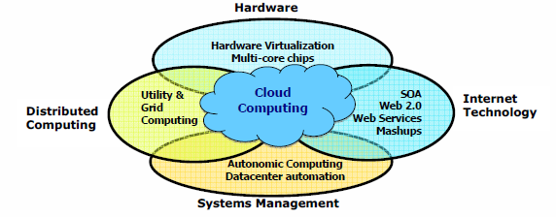
Data Deluge Enabling New Challenges
(Courtesy of Judy Qiu, Indiana University, 2011)

Slide 3
From Desktop/HPC/Grids to
Internet Clouds in 30 Years
HPC moving from centralized supercomputers
to geographically distributed desktops, desksides,
clusters, and grids to clouds over last 30 years
R/D efforts on HPC, clusters, Grids, P2P, and virtual
machines has laid the foundation of cloud computing
that has been greatly advocated since 2007
Location of computing infrastructure in areas with
lower costs in hardware, software, datasets,
space, and power requirements – moving from
desktop computing to datacenter-based clouds

Slide 4
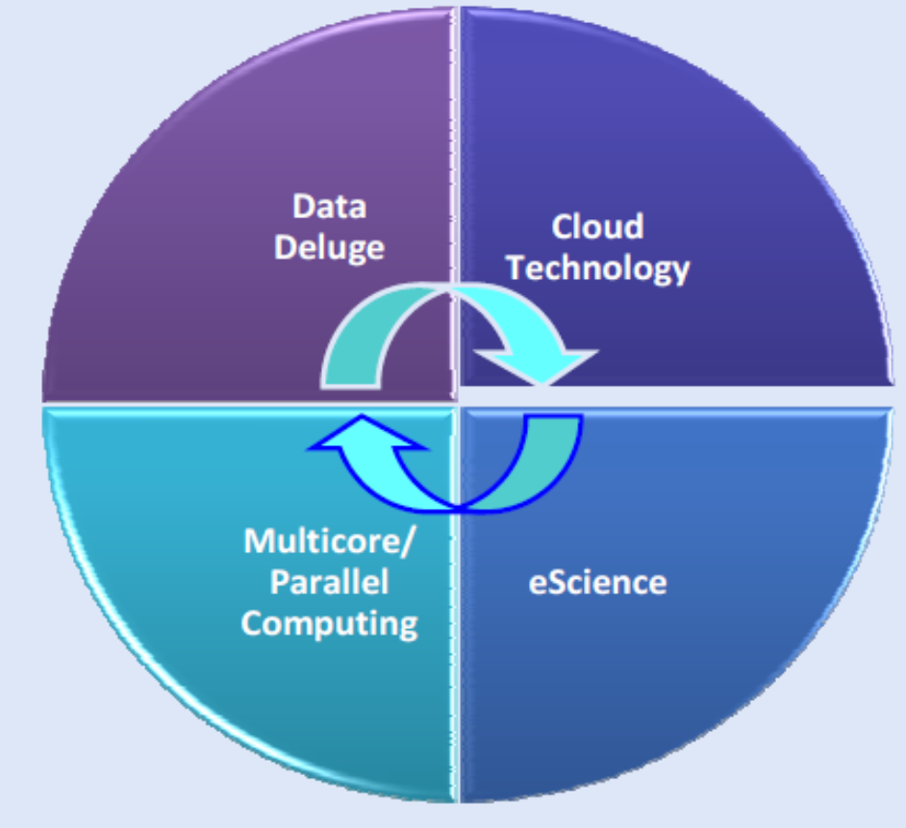
Interactions among 4 technical challenges :
Data Deluge, Cloud Technology, eScience,
and Multicore/Parallel Computing
(Courtesy of Judy Qiu, Indiana University, 2011)

Slide 5
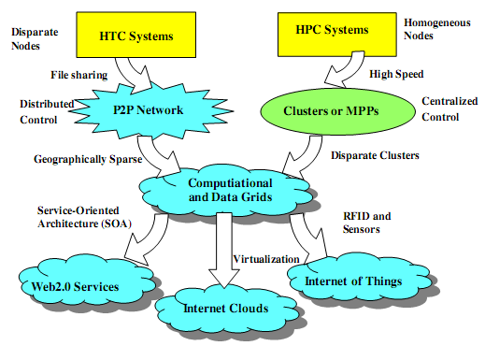
Clouds and Internet of Things
HPC: High-Performance Computing
HTC: High-Throughput Computing
P2P:
Peer to Peer
MPP:
Massively Parallel Processors
Source: K. Hwang, G. Fox, and J. Dongarra,
Distributed and Cloud Computing,
Morgan Kaufmann, 2012.
Notes:
HPC systems emphasize the raw speed performance.
The speed of HPC systems has increased from Gflops in the early 1990s to now Pflops in 2010.
This improvement was driven mainly by the demands from scientific, engineering, and manufacturing communities.
the Top 500 most powerful computer systems in the world are measured by floating-point speed in Linpack benchmark results. However, the number of supercomputer sers is limited to less than 10% of all computer users.
Today, the majority of computer users are using desktop computers or large servers when they conduct Internet searches and market-driven computing tasks.

Slide 6
Computing Paradigm Distinctions
Centralized Computing
  All computer resources are centralized in one physical system.
Parallel Computing
  All processors are either tightly coupled with central shard memory or loosely coupled with distributed memory
Distributed Computing
  Field of CS/CE that studies distributed systems. A distributed system consists of multiple autonomous computers, each with its own private memory, communicating over a network.
Cloud Computing
  An Internet cloud of resources that may be either centralized or decentralized. The cloud apples to parallel or distributed computing or both. Clouds may be built from physical or virtualized resources.
Notes:
This is a computing paradigm by which all computer resources are
centralized in one physical system. All resources (processors, memory, and storage) are fully
shared and tightly coupled within one integrated OS. Many data centers and supercomputers are
centralized systems, but they are used in parallel, distributed, and cloud computing applications
Parallel computing In parallel computing, all processors are either tightly coupled with
centralized shared memory or loosely coupled with distributed memory. Some authors refer to
this discipline as parallel processing [15,27]. Interprocessor communication is accomplished
through shared memory or via message passing. A computer system capable of parallel
computing is commonly known as a parallel computer [28]. Programs running in a parallel
computer are called parallel programs. The process of writing parallel programs is often
referred to as parallel programming [32].
Distributed computing This is a field of computer science/engineering that studies distributed
systems. A distributed system [8,13,37,46] consists of multiple autonomous computers, each
having its own private memory, communicating through a computer network. Information
exchange in a distributed system is accomplished through message passing. A computer
program that runs in a distributed system is known as a distributed program. The process of
writing distributed programs is referred to as distributed programming.
Cloud computing An Internet cloud of resources can be either a centralized or a distributed
computing system. The cloud applies parallel or distributed computing, or both. Clouds can be
built with physical or virtualized resources over large data centers that are centralized or
distributed. Some authors consider cloud computing to be a form of utility computing or service
computing [11,19].

Slide 7
Efficiency
Dependability
Adaptation in the programming model
Flexibility in application deployment

Slide 8
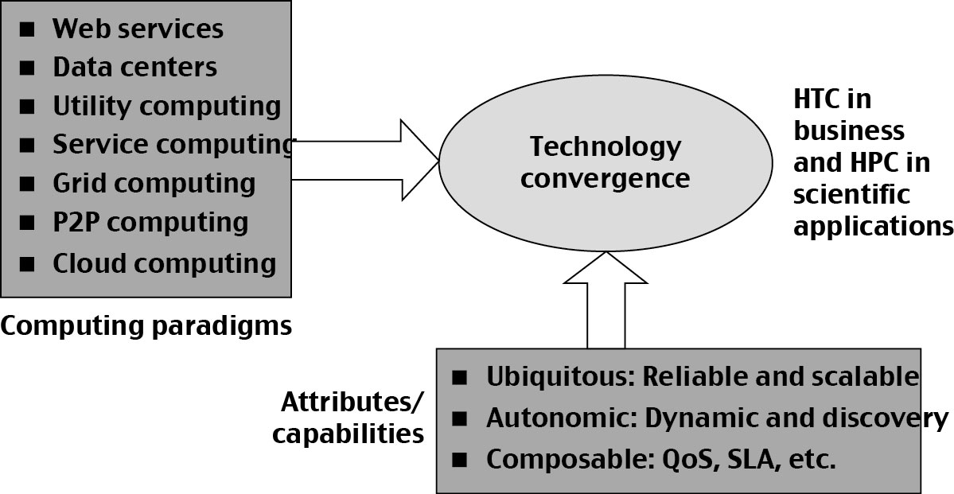
Technology Convergence toward HPC for Science and HTC for Business: Utility Computing
(Courtesy of Raj Buyya, University of Melbourne, 2011)
Copyright © 2012, Elsevier Inc. All rights reserved.

Slide 9
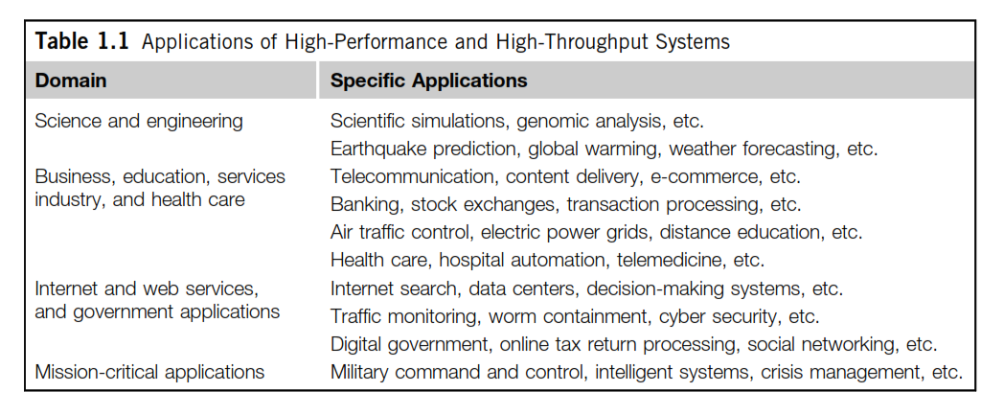

Slide 10
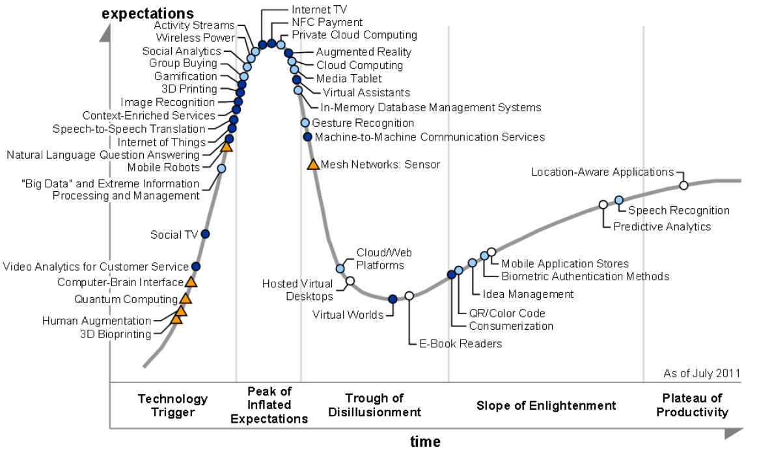
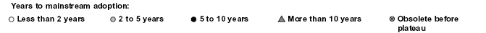
2011 Gartner “IT Hype Cycle” for Emerging Technologies
2010
2009
2011
2008
2007
Copyright © 2012, Elsevier Inc. All rights reserved.

Slide 11
